Slide 1
Decoding Market DNA:
A Machine Learning Regime
Detection Framework
Academic Advisors: Dr. Tao Pang, Mr. Patrick Roberts
Project Leader: Sarang Kansara

Slide 2






Project Team
Aditya Bedi
abedi@ncsu.edu
Siyuan Lu
slu28@ncsu.edu
Paritosh Mallick
ppmallic@ncsu.edu
Isaiah Nick
idnick@ncsu.edu
Gaurav Pai
gpai2@ncsu.edu
Vedashree Teli
vvteli@ncsu.edu

Slide 3
Introduction
Identify distinct market regimes using Gaussian Mixture Models.
Python-based implementation using unsupervised machine learning techniques.
Analyze statistical patterns across the different regimes
Support better risk management and asset allocation decisions.

Slide 4
Coding Methodology
Database Initialization
Data Processing
Data Integration
.
Visualization

Slide 5
Market Regimes
Crisis
Steady State
Inflation
Walking on Ice

Slide 6
Data Sources
01
Bloomberg
Equity
Commodities
Global Fixed Income
02
FRED
Treasury Yields
Macroeconomic Data
03
Kenneth R. French Data Library
Fama-French Research Factors

Slide 7
Feature Selection
78 features selected across 4 categories
01
Equity
S&P 500
MSCI Emerging Markets Index
Fama-French Research Factor
02
Fixed Income
T-Bill Yields
JGB 10-Year
MBS Index
03
Commodities/FX
DXY
WTI Spot
Gold Spot
04
Macroeconomic
GDP Growth
Unemployment
Consumption

Slide 8
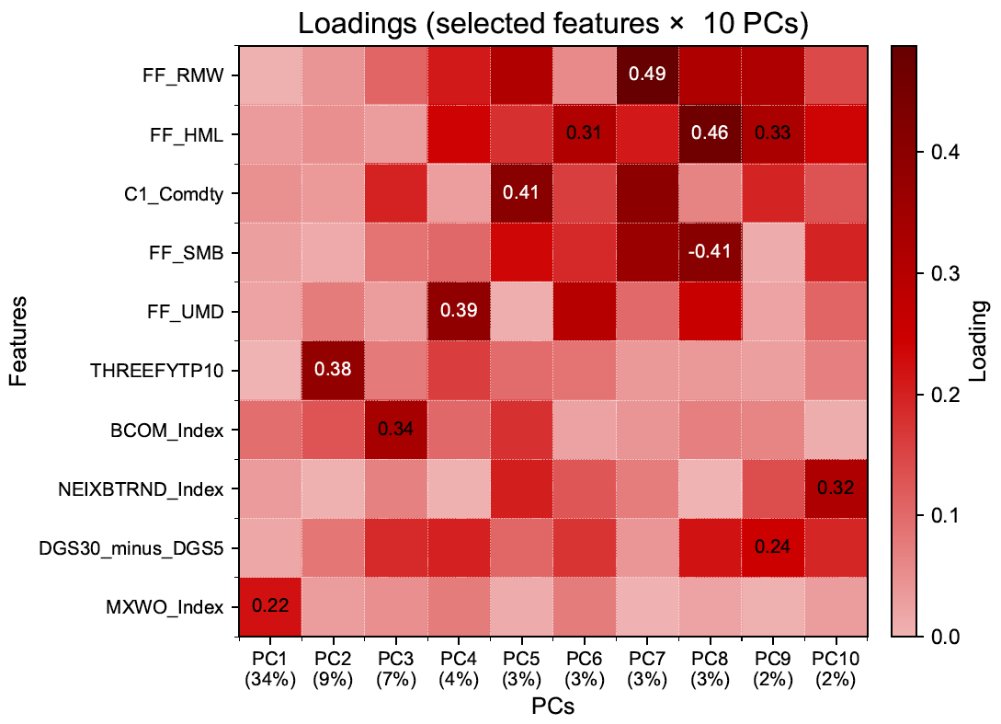
PCA
PC1 | MXWO_Index | +0.22
PC2 | THREEFYTP10 | +0.38
PC3 | BCOM_Index | +0.34
PC4 | FF_UMD | +0.39
PC5 | C1_Comdty | +0.41
PC6 | FF_HML | +0.31
PC7 | FF_RMW | +0.49
PC8 | FF_SMB | -0.41
PC9 | DGS30_minus_DGS5 | +0.24
PC10 | NEIXBTRND_Index | +0.32

Slide 9
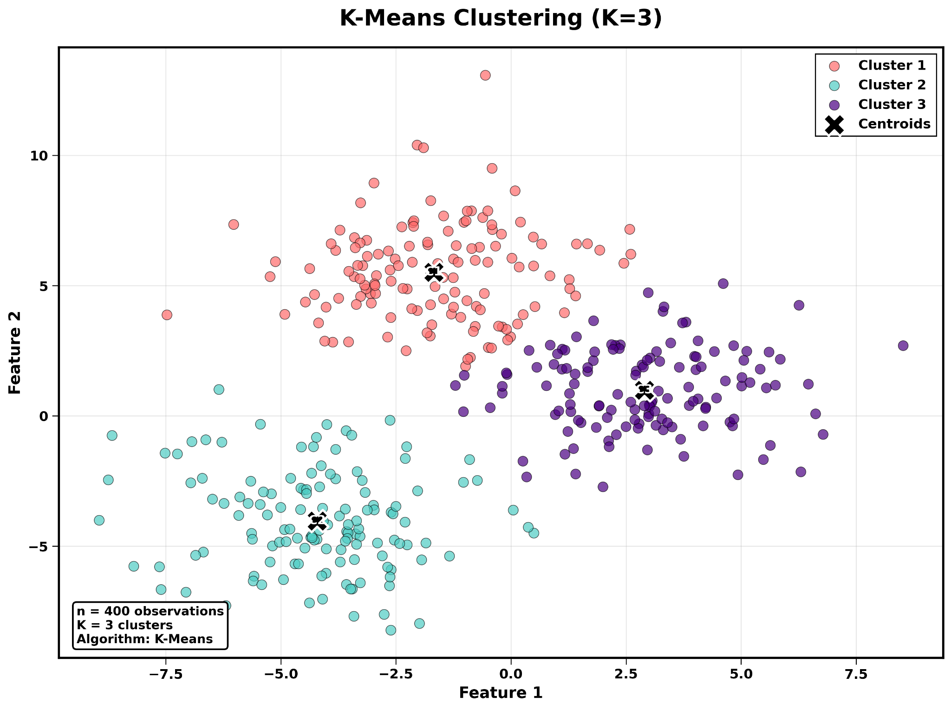
K- Means
• Unsupervised learning algorithm
• Groups data into K clusters based on similarity
• Minimizes within-cluster variance
• Each cluster represented by a centroid

Slide 10

Gaussian Mixture Models
The Gaussian Mixture Model (GMM) is a probabilistic model that assumes data (like market returns) is generated from a mixture of several underlying groups, or regimes.
Core Assumption: The market is not one distribution, but a weighted sum of K hidden normal distributions (regimes).
Regime Definition: Each regime k is defined by three parameters:
  Weight (π_{k}​): How often the regime occurs.
  Mean (μ_{k}​): The average return of the regime.
  Covariance (Σ_{k​}): The volatility and correlation structure.
Notes:
The Gaussian Mixture Model, or GMM, is a powerful probabilistic tool for regime detection. It assumes that our financial data—like market returns—isn't generated by a single, monolithic distribution, but rather a blend, or mixture, of several distinct underlying groups, which we call regimes.
(0:15) Core Assumption and Regime Definition
The core assumption is simple: the market is a weighted sum of K hidden normal distributions. Each of these $K$ regimes is fully defined by three key parameters:
Weight ($\pi_k$): This tells us the long-term frequency or probability of that regime occurring.
Mean ($\mu_k$): This represents the average return we expect during that specific regime.
And Covariance ($\Sigma_k$): This captures the volatility and the correlation structure of assets within that regime.

Slide 11

Gaussian Mixture Models
Expectation-Maximization (E-M) Algorithm
E-Step (Expectation)
Goal: Calculate the probability (γ_{nk}​) that each return belongs to each regime.
Result: A "soft assignment" where every data point is fractionally assigned to every regime.
M-Step (Maximization)
Goal: Update the regime parameters (π_{k}​, μ_{k}​, Σ_{k}​).
Process: Use the E-Step probabilities (γ) as weights to recalculate the mean, covariance, and weight for each regime.
Notes:
GMM is solved using an iterative process called the Expectation-Maximization, or E-M Algorithm. This alternates between two steps until the model converges:
The E-Step (Expectation) calculates the probability—we call it $\gamma_{nk}$—that each individual data point belongs to each regime. The result is a "soft assignment", where every return is fractionally assigned to every regime.
Then, the M-Step (Maximization) uses these "soft" probabilities as weights to re-estimate or maximize the regime parameters—the weights, means, and covariances.
The model cycles through this E-Step/M-Step until the parameters stabilize, giving us our final, distinct regimes

Slide 12
Performance Metrics
AIC/BIC
Silhouette Score
Regime metrics

Slide 13
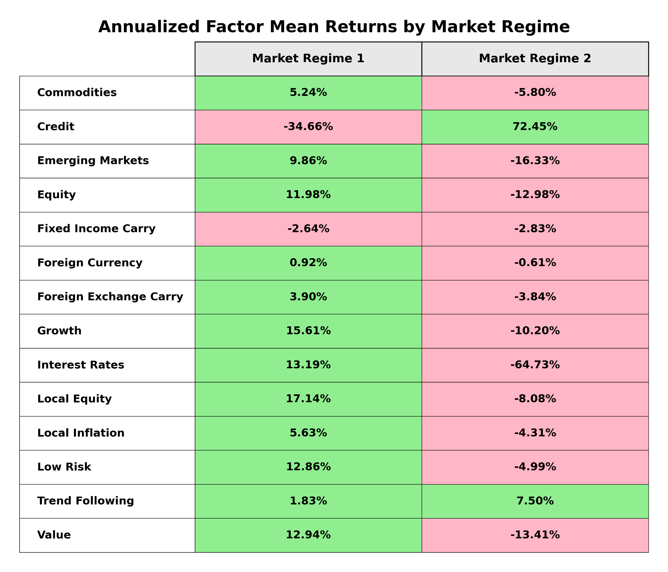
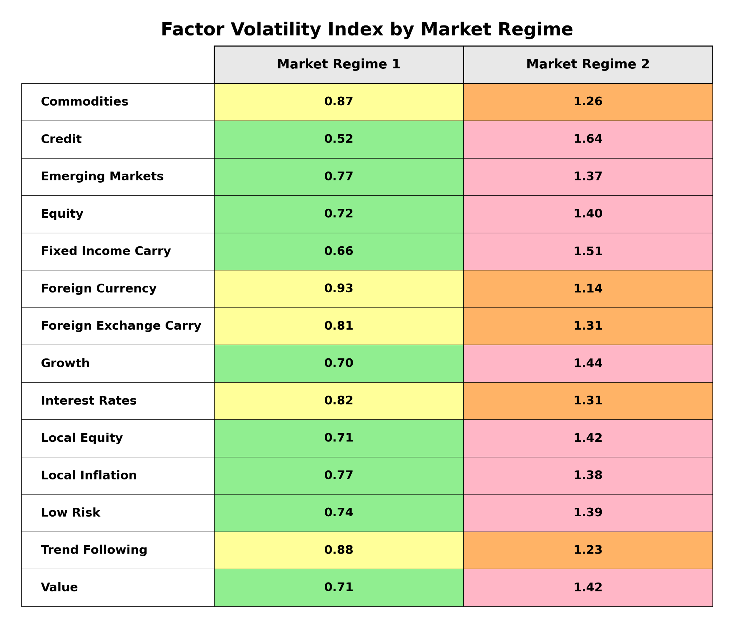
Results

Slide 14
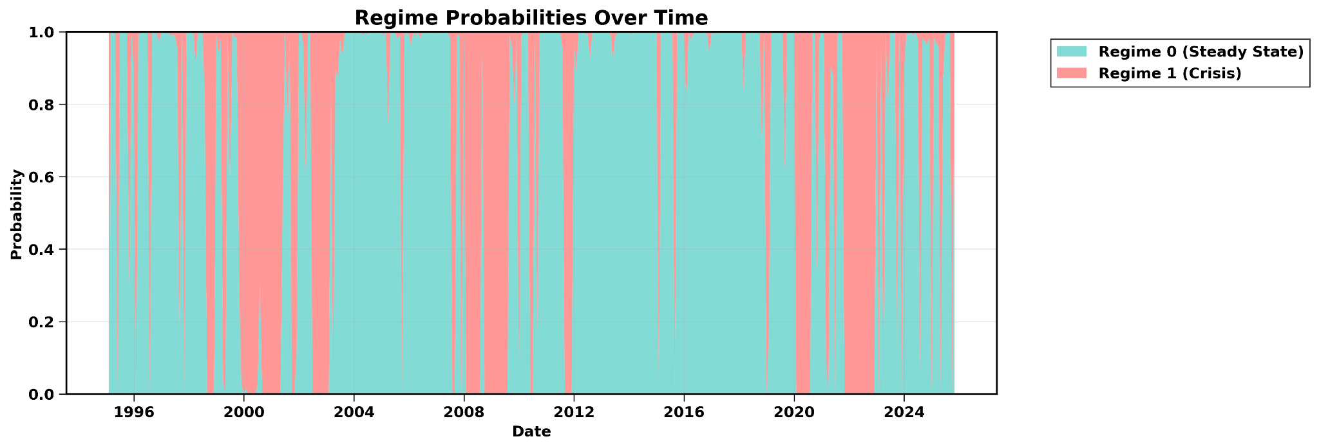

Slide 15
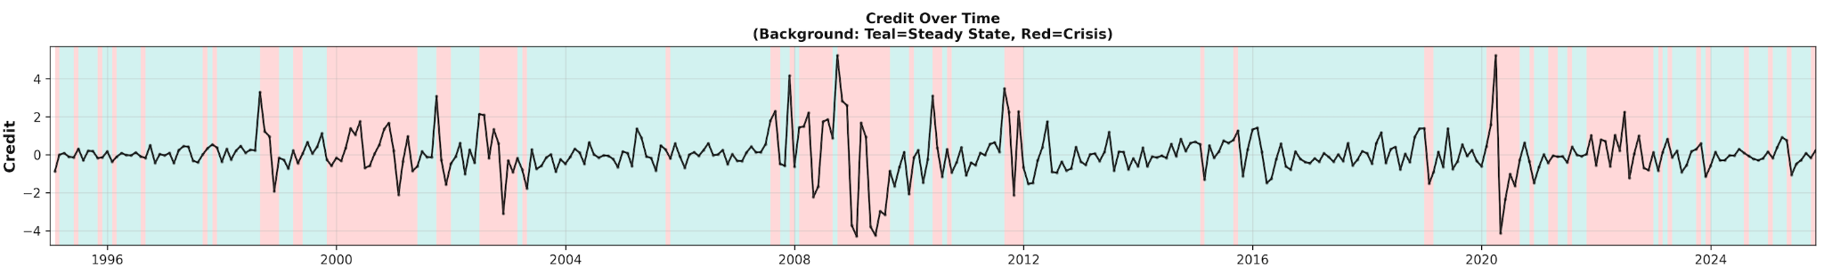
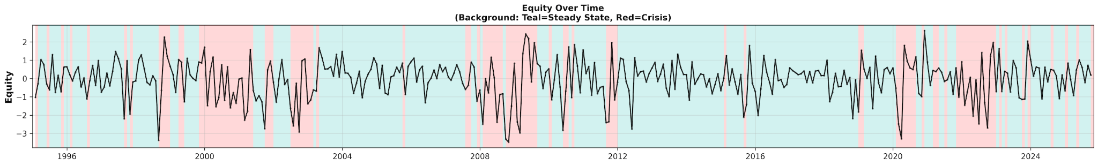
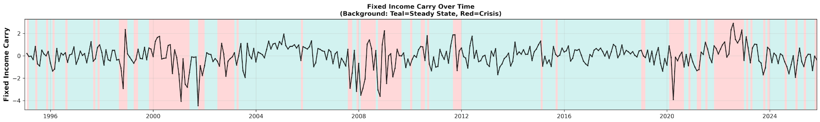

Slide 16
Challenges
Iteration and Analysis
Interpreting regimes, refining inputs, repeating
Data Processing
Cleaning, aligning, and standardizing 30+ years of mixed-frequency data
Feature Selection
Balancing dimensionality versus interpretability

Slide 17
Future Work
So far
What’s next
Detected a robust time series of market regime dynamics
Stress test investment strategies across varying regime dynamics

Slide 18
Thank you!

Slide 19
Market Regimes
Crisis
Broad de-risking that equities and credit fall and volatility and correlations rise.
Steady State
Calm and balanced environment with broadly positive risk premia and stable trends.
Inflation
Inflation hedges lead because higher rates pressure bonds and equities lag.
Walking on ice
Risky but fragile that prices advance while choppiness and reversal risk stay elevated.

Slide 21
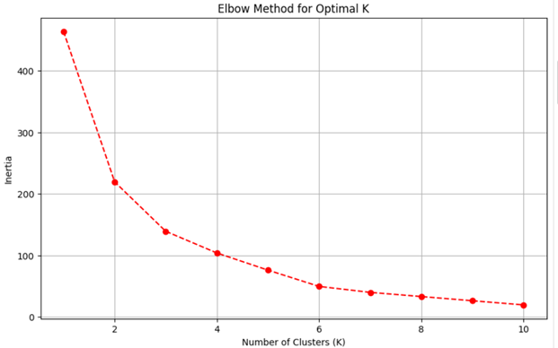
Choosing the Right Number of Clusters (K)
• No fixed rule — depends on data pattern
• Elbow Method: Plot inertia vs K.
• Silhouette Score: Measures cluster separation
• Select K where model performance stabilizes

Slide 22

Gaussian Mixture Models
The Core Model: The probability of observing a market return on a given day (x_{n​}) is a weighted sum of its probability in each of the K possible regimes.
Explanation: This formula defines a regime. Each regime k has a weight (π_{k​}), an average return (μ_{k}​), and a volatility/correlation structure (Σ_{k}​).
The Challenge: Maximum Likelihood To find the best parameters, we need to maximize the log-likelihood of our data.
Explanation: The sum inside the logarithm makes this equation very difficult to solve directly. We don't know which regime generated a specific day's return, so we can't easily optimize the parameters.

Slide 23
Gaussian Mixture Models
Expectation-Maximization (E-M)
The E-Step: Calculate Regime Probabilities ("Responsibilities") First, we calculate the probability that each day n belongs to each regime k.
Explanation: This is a "soft assignment." For each day, we get a score for every regime (e.g., 70% chance it was Regime 1, 30% chance it was Regime 2).
The M-Step: Update the Regime Definitions Next, we use these responsibility scores (γ) as weights to update the parameters for each regime.
  Update Mean (μ_{k}​): The regime's new average return is the weighted average of all returns.
  Update Covariance (Σ_{k}​): The regime's new volatility/correlation is the weighted average of daily price movements.
  Update Weight (π_{k​}): The regime's new overall weight is the average responsibility it had across all days.

Slide 24
Coding Methodology
Created a github and collaborated with others there
Database Initialization: Set up the schema and structure to store financial and microeconomic data.
Data integration: From there pulled APIs and files from Bloomberg, FRED and Fama-French sources
Data Processing: computed returns, created consistent identifiers for assets/instruments across models for reproducibility, managed dependencies with pandas, numpy, statsmodels and SQLAlchemy.
Visualization: Developed visualizations to display and interpret GMM results.

